Slide 1
Inland Empire Health Plan
Effective Communication: Leveraging Alternate Formats in Healthcare

Slide 2
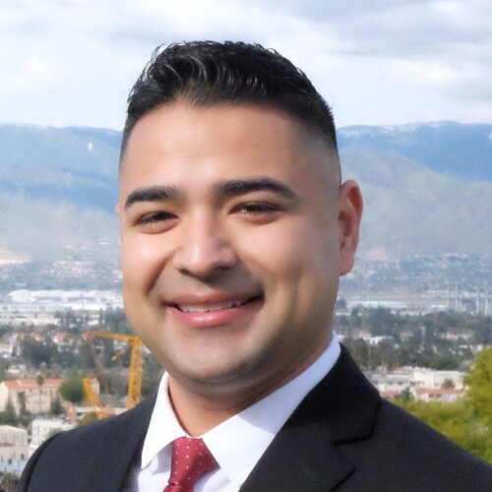
TODAY’S SPEAKERS
Gabriel Uribe, DSW Director of Community Health
Karla Argandoña Community Health Analyst
Dr. Uribe serves as the Director of Community Health at the Inland Empire Health Plan (IEHP). His contributions in the areas of community health, program design, diversity and inclusion, policy development and social innovation have been key to the development of community collaboration initiatives in IEHP’s catchment area.
Karla is a senior Analyst at Inland Empire Health Plan (IEHP) Community Health team and is responsible for the implementation and development of enterprise-wide social support programs. She is a leading expert in healthcare communication accessibility for people with access and functional needs and has been with IEHP since 2015.
2
Notes:
Stephanie Waite, Associate Director, Product Intelligence, UnitedHealthcare Community Plan – WI

Slide 3
Agenda
About IEHP
Effective Communication overview
Alternative Formats
Health Policy Governing Alternate Formats for Medi-Cal Health Plans and their Provider Network
Building Communication Capacity in the Alternative Format/ Communication Space

Slide 4
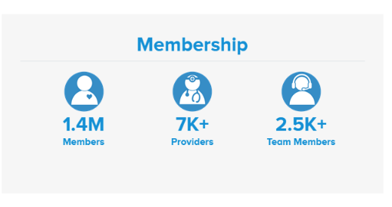
ABOUT INLAND EMPIRE HEALTH PLAN
IEHP is a top 10 largest Medicaid health plan and the largest not-for-profit Medicare-Medicaid plan in the country.
IEHP serves low-income individuals and families in San Bernardino and Riverside County in California.

Slide 5
WHAT IS EFFECTIVE COMMUNICATION?

Slide 7
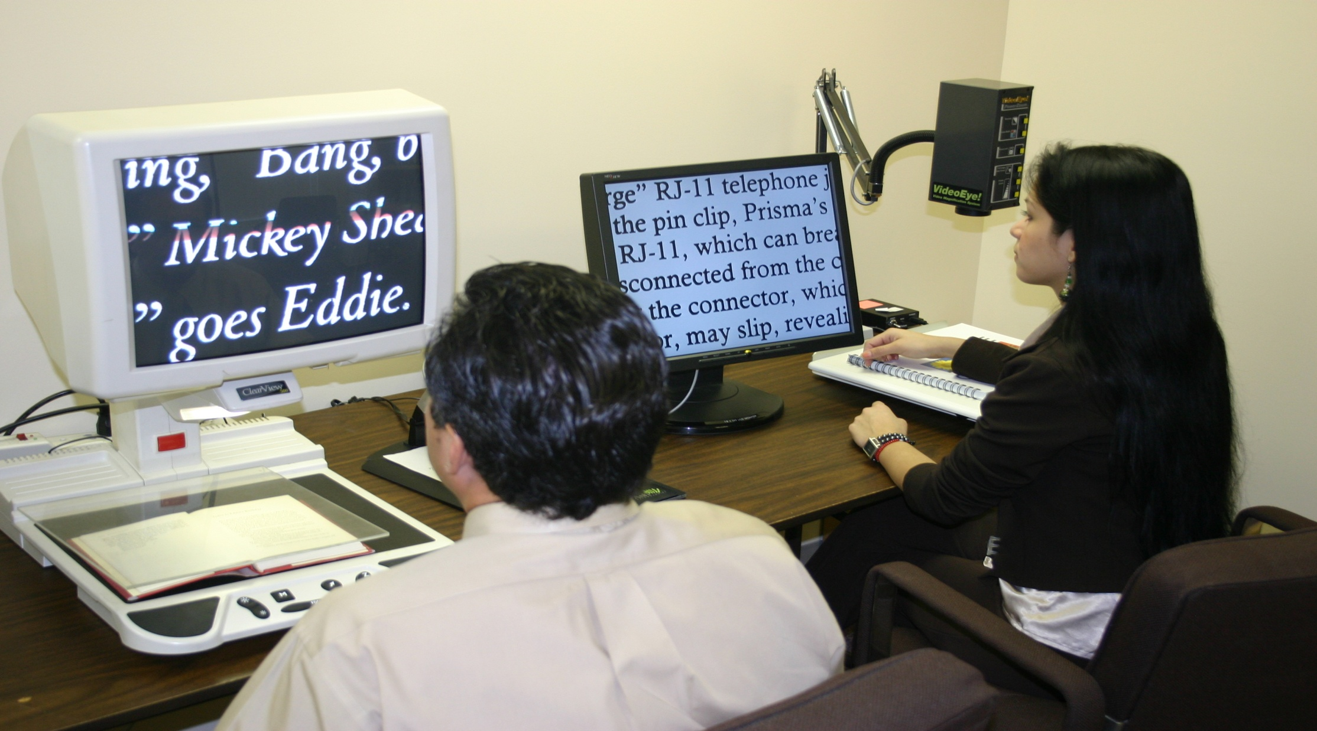
ASSISTIVE TECHNOLOGY

Slide 8
Video Remote Interpreting (VRI)

Slide 9
ALTERNATIVE FORMATS
IEHP Members can receive Member informing/specific materials in alternative formats.
Independent Living & Diversity Services can assist departments with providing alternative format transcription services in the following available alternative formats:
Braille
Large Print
E-Text
Audio
Text to ASL
Notes:
Alternative Format Request can done by sending a referral to the ILDS team in Community Health.
Braille
Large Print for ID cards 8.5x11
Electronic Text
Daisy-Digital Access information system-Audio Book
Audio-Tape/CD

Slide 10
Some Members with access or functional needs also have LEP?
Individuals who do not speak English as their primary language and who have a limited ability to read, speak, write, or understand English, may be considered limited English proficient (LEP)*.
Between 1990 and 2010, the U.S. Limited English Proficiency (LEP) increased by 80%*.
19.8% of California’s overall population is LEP*.
Language Proficiency
* U.S. Department of Health and Human Services OPHS, Office of Minority Health National Standards for Culturally and Linguistically Appropriate Services in Health Care
* Module 2: Cultural Competency: Race, Ethnicity, Language, and Unconscious Bias in Health Care, Cheri Wilson, MA, MHS, CPHQ
Notes:
Which is why we provide Interpreting Services-To remove the language barriers

Slide 11
Receive lower quality health care
Poorer compliance with medical recommendations.
Higher risk of medical errors.
Difficulties understanding their diagnosis or why they receive particular types of care.
Disproportionately high rates of infectious disease and infant mortality.
Discordant communication resulting in both lower patient and clinician satisfaction.
Perils of Having LEP
* Module 2: Cultural Competency: Race, Ethnicity, Language, and Unconscious Bias in Health Care, Cheri Wilson, MA, MHS, CPHQ

Slide 12
Member is quiet or does not respond to questions.
Member simply says yes, no, or gives inappropriate or inconsistent answers to your questions.
Member may have trouble communicating in English or you may have a very difficult time understanding what they are trying to communicate.
Member identifies as having LEP by requesting language assistance.
How to Identify a Member with LEP over the Phone
* Industry Collaboration Effort Cultural and Linguistics Provider Tool Kit

Slide 13
LINGUISTIC SERVICES
Written Member-informing materials must be translated into IEHP’s threshold languages.
At this time, DHCS has designated English, Spanish, Mandarin (Chinese) and Vietnamese as the only threshold languages in San Bernardino and Riverside Countries for IEHP.

Slide 14
Health Policy Governing Alternate Formats for Medi-Cal Health Plans and Their Provider Network

Slide 15
APL 22-002
BACKGROUND:
The Americans with Disabilities Act (ADA) requires that services, programs, and activities provided by public entities must be accessible to individuals with disabilities, including visual impairment.
Medi-Cal managed care health plans (MCPs) are subject to the standards of Title II of the ADA, including standards for communicating effectively with individuals with disabilities to ensure they benefit equally from government programs.

Slide 16
APL 22-002
POLICY:
MCPs must accommodate the communication needs of all qualified members with disabilities, including Appointed Representative, and be prepared to facilitate alternative format requests for Braille, audio format, large print (no less than 20 point Arial font), and accessible electronic format, such as a data CD, as well as requests for other auxiliary aids and services that may be appropriate.

Slide 17
APL 22-002
POLICY:
If a member selects an electronic format, such as an audio or data CD, the information may be provided unencrypted (i.e., not password protected), but only with the member's informed consent. MCPs must inform a member who contacts the MCP regarding an electronic alternative format, that unless the member requests a password protected format, the member will receive notices and information in an electronic format that is not password protected, which may make the information more vulnerable to loss or misuse. MCPs must make clear that members may request an encrypted (i.e., password protected) electronic format. If the member requests notices and information in a password protected electronic format, the MCP must provide a password protected electronic format with unencrypted instructions on how the member is to access the encrypted information.

Slide 18
Building Communication Capacity in the Alternative Format/ Communication Space

Slide 19
HOW DO WE BUILD CAPACITY?
Network Providers
Pharmacy Benefit Manager
Independent Physician Association
Relationships
Vendor
Service Level Agreement
Community Base Organizations

Slide 20
WHAT IS YOUR CURRENT PROCESS?
Inhouse, identify key players
Information Technology
Healthcare Informatics
Enrollment unit
Team members (Independent Living & Diversity Services)
Do you have a team?
Do you have a repository location?
Identifying the type of alternative format request
Standing request
One time request

Slide 21
IEHP CURRENT REQUEST BY CATAGORY
Large Print 89%
Audio 7%
Electronic 3%
Braille 1.6%
Text to ASL .2%
Increase by 1500%

Slide 22
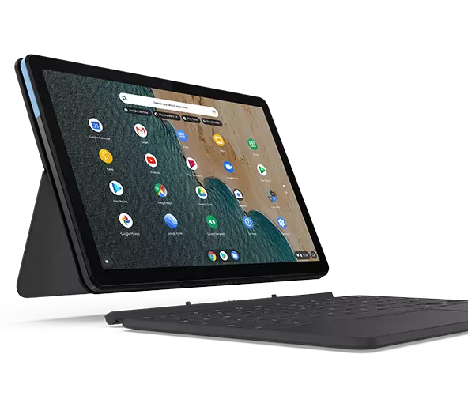
Scenarios
Member who is blind calls the Health Plan and ask for a provider directory in braille.
Member with low vision is unable to memorize their member ID number.
Member with low vision stated he can no longer receive his materials in audio CD, due to not having a device to hear the audio.
Member with low vision is requesting to receive his material in braille, but member does not read braille.

Slide 23
THANK YOU FOR ATTENDING
Gabriel Uribe, DSW Director of Community Health
Inland Empire Health Plan (IEHP)
uribe-g@iehp.com
Karla Argandoña
Analyst, Community Health
Inland Empire Health Plan (IEHP)
argandona-k@iehp.org

Slide 24
Questions?

